Slide 1
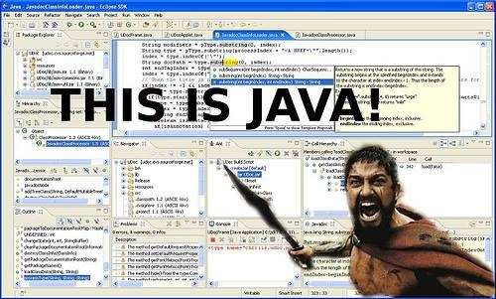
What is Java?

Slide 2
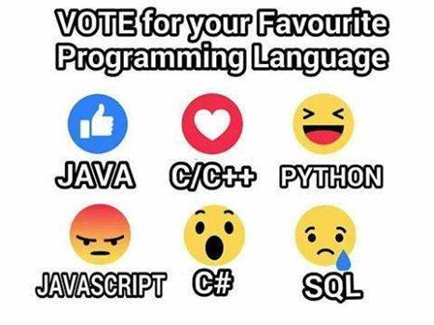

Slide 3
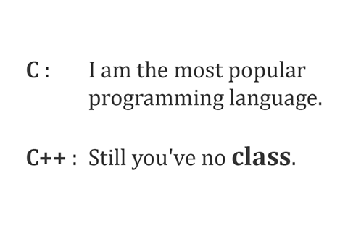

Slide 4
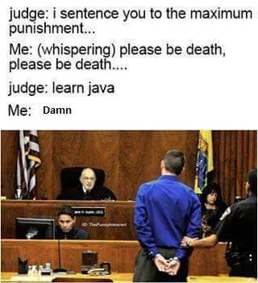
Is Learning java a punishment?

Slide 5
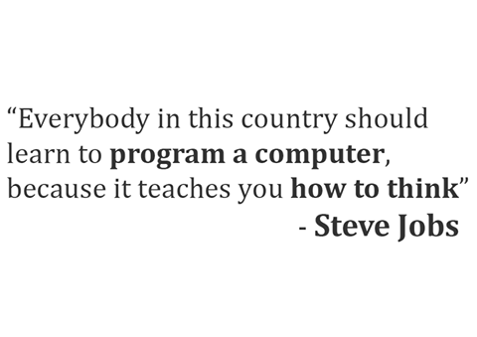

Slide 6
4 resources for a true Java programmer:
- Java Trademark: http://java.com
- Java Technology: http://java.oracle.com
- Javadoc sites:
+ Java SE APIs: http://docs.oracle.com/javase/8/docs/api
+ Java EE APIs: http://docs.oracle.com/javaee/7/api
- The Java Tutorial Series:
+ Java SE Tutorial: http://docs.oracle.com/javase/tutorial
+ Java EE Tutorial: http://docs.oracle.com/javaee/7/tutorial

Slide 7
What are the best websites to practice Java coding?
www.leetcode.com
www.odingbat.com
www.hackerearth.com
www.hackerrank.com
www.techgig.com
Former two are only for practice. Later two can also fetch you job.

Slide 8
Which subjects in the Java language are useless to learn nowadays?
Applets
JSP
RMI, both RMI JRMP and RMI IIOP
EJB 1 and 2, BMP and CMP
WebSphere, WebLogic and other application servers
CORBA bindings to Java
XML (ish)
JAXB
SOAP
JAX-WS
Java Web Start
AWT
SWING
Ant builds
WAR files (prefer embedded servers)
Raw JDBC
Pre-generic Collections
Serialization (ish; except for mapper tools)
Arrays (ugh. I mean, you have to, but. Ugh. Prefer collections)
Raw Threads (prefer util.concurrent)
Struts
ibatis

Slide 9
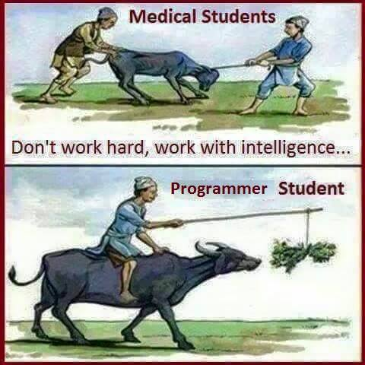
Funny pic

Slide 10
What is Java
Java is a programming language and a platform Independent
Java is a high level, robust, secured, multi threaded, and object-oriented programming language.
Platform: Any hardware or software environment in which a program runs, is known as a platform.

Slide 11
Java Example
class HelloWorld{
public static void main(String args[]){
System.out.println("Hello Java");
}
}

Slide 12
Where it is used?
According to Sun, 3 billion devices run java. There are many devices where java is currently used. Some of them are as follows:
Desktop Applications such as acrobat reader, media player, antivirus etc.
Web Applications such as irctc.co.in, passport.gov.in etc.
Enterprise Applications such as banking applications (icici.com, onlinesbi.com)
Mobile Applications
Embedded System
Smart Card
Robotics
Games etc.

Slide 13
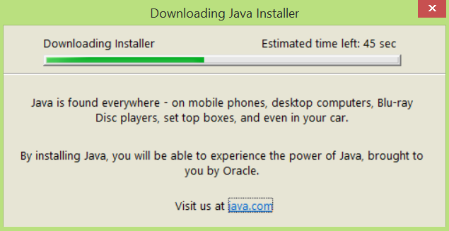

Slide 14
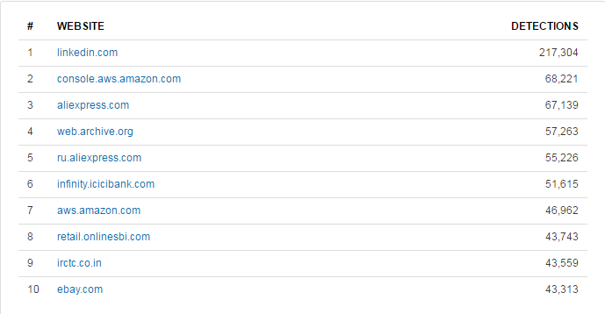
What are some famous websites written in Java?

Slide 15
Very difficult to give credit to one application language if you are talking about a big web applications. They generally will have several language stacks..
Linkedin is primarily written in Java
Amazon(High Scalability - High Scalability - Amazon Architecture) also uses java in addition to other languages.
Facebook uses HBase (a Java based No-SQL DB) as messaging platform and also uses Java in other areas see - Facebook Engineering: What is Facebook's architecture?
Ebay (EBay Architecture) uses Java
Google uses Java extensively in Google Plus, GTalk (High Scalability - High Scalability - GoogleTalk Architecture) etc

Slide 16
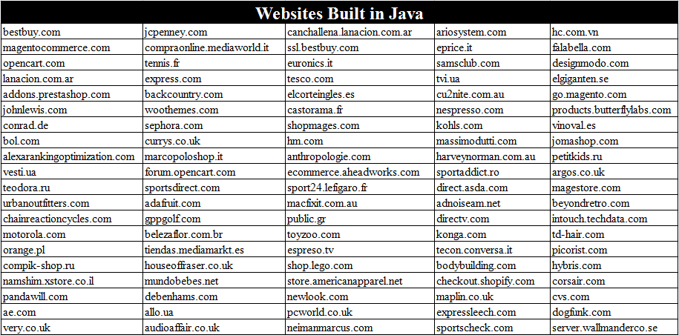
Some more websites Built in Java

Slide 17
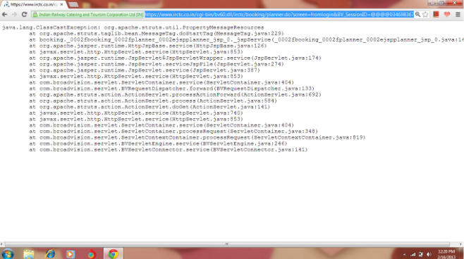
The Online Indian Railway Booking System. Below attached is a rare snap that bolsters the evidence.

Slide 18
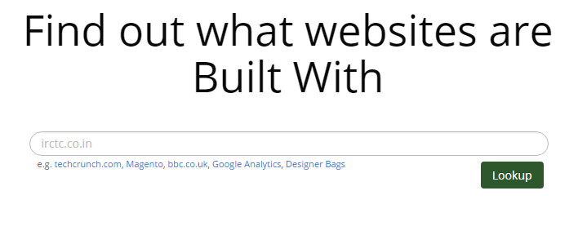
Tool to detect website development language
www.builtwith.com
http://onlinewebtool.com/cmsdetector.php - for CMS detection
http://guess.scritch.org/ - Detect CMS, web framework

Slide 19
Types of Java Applications
There are mainly 4 type of applications that can be created using java programming:
1) Standalone Application
It is also known as desktop application or window-based application. An application that we need to install on every machine such as media player, antivirus etc. AWT and Swing are used in java for creating standalone applications.
2) Web Application
An application that runs on the server side and creates dynamic page, is called web application. Currently, servlet, jsp, struts, jsf etc. technologies are used for creating web applications in java.
3) Enterprise Application
An application that is distributed in nature, such as banking applications etc. It has the advantage of high level security, load balancing and clustering. In java, EJB is used for creating enterprise applications.
4) Mobile Application
An application that is created for mobile devices. Currently Android and Java ME are used for creating mobile applications.

Slide 20
History of Java
Java history is interesting to know. The history of java starts from Green Team.
Java team members (also known as Green Team), initiated a revolutionary task to develop a language for digital devices such as set-top boxes, televisions, and Remote devices etc.
Currently, Java is used in internet programming, mobile devices, games, e-business solutions etc. There are given the major points that describes the history of java.

Slide 21
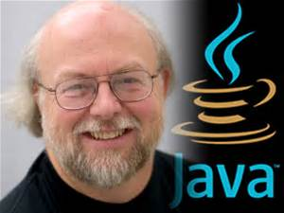
1) James Gosling, Mike Sheridan, and Patrick Naughton initiated the Java language project in June 1991. The small team of sun engineers called Green Team.
2) Originally designed for small, embedded systems in electronic appliances like set-top boxes.
3) Firstly, it was called "Greentalk" by James Gosling and file extension was .gt.
4) After that, it was called Oak and was developed as a part of the Green project.
Father of the Java is James Gosling

Slide 22

Why Oak name for java language?
5) Why Oak? Oak is a symbol of strength and chosen as a national tree of many countries like U.S.A., France, Germany, Romania etc.
6) In 1995, Oak was renamed as "Java" because it was already a trademark by Oak Technologies.

Slide 23
Why Java name for java language?
7) Why they choosen java name for java language? The team gathered to choose a new name. The suggested words were "dynamic", "revolutionary", "Silk", "jolt", "DNA" etc. They wanted something that reflected the essence of the technology: revolutionary, dynamic, lively, cool, unique, and easy to spell and fun to say.
According to James Gosling "Java was one of the top choices along with Silk". Since java was so unique, most of the team members preferred java.
8) Java is an island of Indonesia where first coffee was produced (called java coffee).
9) Notice that Java is just a name not an acronym.
10) Originally developed by James Gosling at Sun Microsystems (which is now a subsidiary of Oracle Corporation) and released in 1995.
11) In 1995, Time magazine called Java one of the Ten Best Products of 1995.
12) JDK 1.0 released in(January 23, 1996).

Slide 24
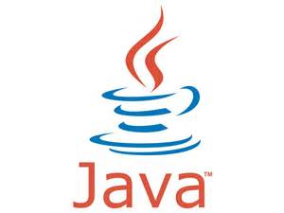
Java Logo

Slide 25
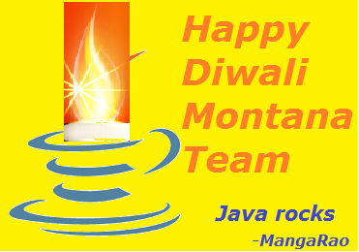
Diwali rebranded powered by java

Slide 26
Java Modules
J2SE
J2EE
J2ME

Slide 27
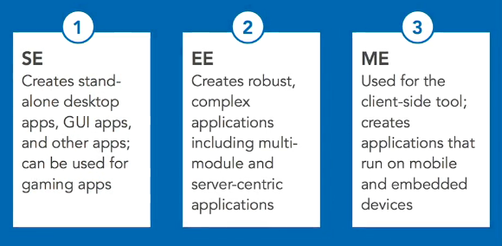
Java platforms compared SE vs EE vs ME

Slide 28
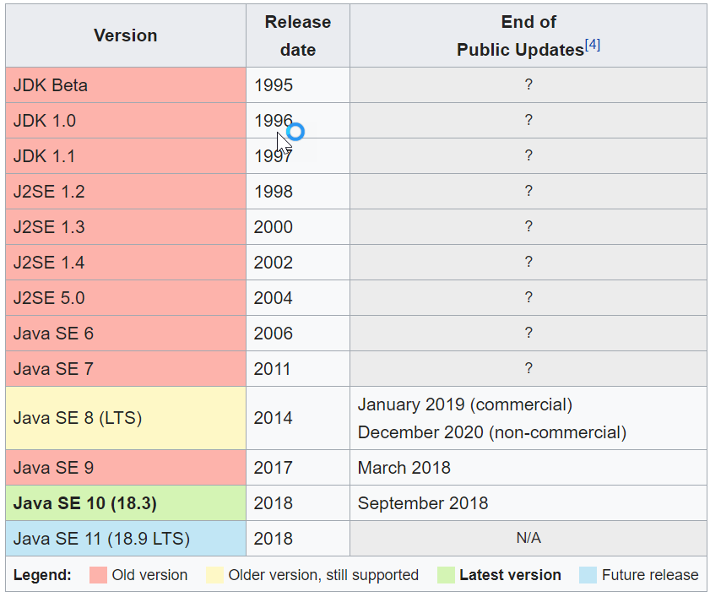
Java Version History There are many java versions that has been released.

Slide 29
what is a significance of “Java 2” in J2EE? Or What is the meaning of 2 in J2SE or J2EE
Java SE was known as Java 2 Platform, Standard Edition or J2SE from version 1.2 until version 1.5. The "SE" is used to distinguish the base platform from Java EE and Java ME. The "2" was originally intended to emphasize the major changes introduced in version 1.2, but was removed in version 1.6. The naming convention has been changed several times over the Java version hist
Emphasize means give special importance or prominence to (something) in speaking or writing.

Slide 30
Note:
Sun Microsystems has renamed the new J2 versions as Java SE, Java EE and Java ME, respectively. Java is guaranteed to be Write Once, Run Anywhere.

Slide 31
Features of Java
Simple
Object-Oriented
Platform independent
Secured
Robust
Architecture neutral
Portable
Dynamic
Interpreted
High Performance
Multithreaded
Distributed

Slide 32
Simple
According to Sun, Java language is simple because:
syntax is based on C++ (so easier for programmers to learn it after C++).
removed many confusing and/or rarely-used features e.g., explicit pointers, operator overloading etc.
No need to remove unreferenced objects because there is Automatic Garbage Collection in java.

Slide 33
Why pointers are eliminated in Java?
Pointers lead to confusion for a programmer. Pointers may crash a program. Using pointer virus and hacking programs can be written.

Slide 34
Object-oriented
OOPS is a concept.
Java provided implementation to the OOPS concepts. Hence Java is OOPL.
Object-oriented means we organize our software as a combination of different types of objects that incorporates both data and behavior.
Object-oriented programming(OOPs) is a methodology that simplifies software development and maintenance by providing some rules.

Slide 35
Basic concepts of OOPs are:
Abstraction
Encapsulation
Polymorphism
Inheritance
Java provided implementation to all the oops concepts.

Slide 36
Note
C++ is partial object oriented programming language because without creating an object or a class we can write a C++ program.
Whereas, without creating at least one class we can't write a java program.

Slide 37
Platform Independent
A platform is the hardware or software environment in which a program runs. There are two types of platforms software-based and hardware-based. Java provides software-based platform. The Java platform differs from most other platforms in the sense that it's a software-based platform that runs on top of other hardware-based platforms.It has two components: Runtime Environment
API(Application Programming Interface)
Java code can be run on multiple platforms e.g.Windows,Linux,Sun Solaris,Mac/OS etc. Java code is compiled by the compiler and converted into bytecode.This bytecode is a platform independent code because it can be run on multiple platforms i.e. Write Once and Run Anywhere(WORA).

Slide 38
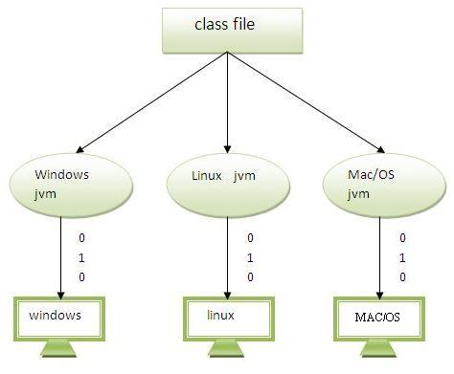
Platform Independent

Slide 39
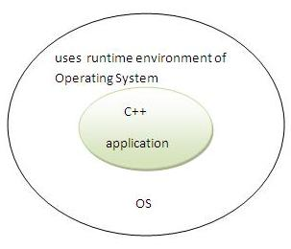
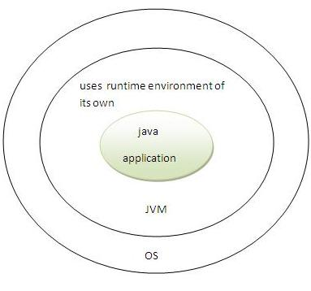
Secured
Java is secured because
No explicit pointer
Programs run inside virtual machine sandbox.

Slide 40
Robust
Java programs will not crash easily because of its exception handling and its memory management features (Garbage Collector).
Memory management was handled by JVM> i.e.; allocation and de-allocation of memory handled by JVM..
Memory Allocation: JVM's class loader sub system will allocate required memory for a program.
Memory de-allocation: JVM's garbage collector will free the allocated memory. Garbage collector will check the memory between every time interval and it used Mark and Sweep algorithm to de-allocate the memory for unused variables and objects.
Exception handling: Exception means a run time error. In Java we can handle the exceptions.

Slide 41
Architectural-neutral
Java's byte code is not machine dependent.
It can be run on any machine with any processor and with any O/S.
It is nothing but processor independent or Hardware Independent

Slide 42
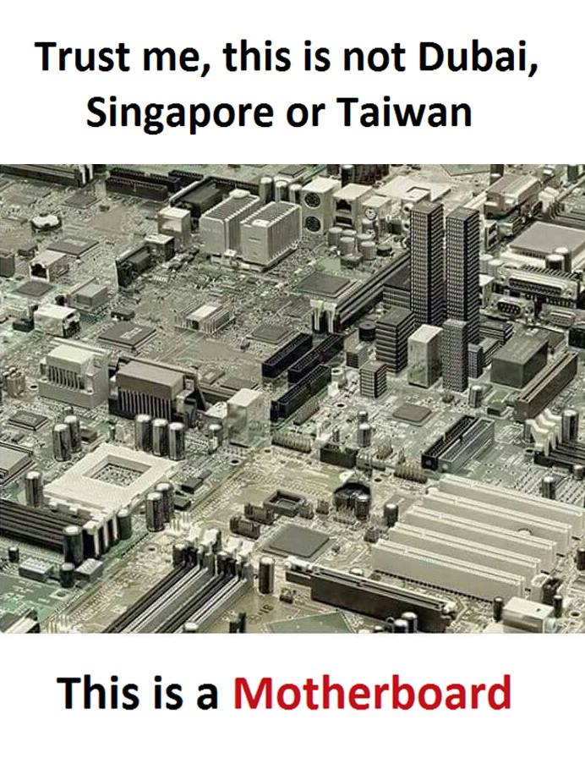

Slide 43
Portable
A program yielding the same result on any computer is said to be portable.
Java program give same results on all machines. Everything is clearly defined in Java specification and nothing is left to O/S.
Note: Compiler in Java is written in ANSI C with a clean portability boundary

Slide 44
Interpreted
Java programs are compiled to generate the byte code. This byte code can be downloaded and interpreted that means byte code is converted into machine code by the interpreter in JVM.
source code --compiler - byte code
byte code --interpreter - binary code
Java uses both compiler and intrepreter.

Slide 45
High-performance
Java has Just In time compiler
JIT: Just In time Compiler increases the performance of the program execution

Slide 46
Distributed
Java is a distributed technology.
Information is distributed on various computers on a network. Using Java, we can write programs which capture information and distribute ii to clients.
RMI and EJB are used for creating distributed applications.

Slide 47
Multithreaded
A thread is like a separate program, executing concurrently.
We can write Java programs that deal with many tasks at once by defining multiple threads.
The main advantage of multi-threading is that it shares the same memory.
Multithreading is used in multi-media, animation and in gaming applications etc.

Slide 48
Dynamic
We can develop programs in Java, which dynamically interact with the user on internet (Eg: Applets)

Slide 49
Translators
Compiler
Interpreter

Slide 50
***Difference between Compiler and Interpreter
Compiler converts entire source code in to binary code
Interpreter converts line by line code in to binary code

Slide 51
Simple Program of Java
Requirement for Java Example
install the JDK if you don't have installed it, download the JDK and install it.
set path of the jdk/bin directory.
create the java program
compile and run the java program

Slide 52
Creating HelloWorld java class
class HelloWorld{
public static void main(String args[]){
System.out.println("Hello World");
}
}
Save as HelloWorld.java
To compile: javac HelloWorld.java
To execute: java HelloWorld
Output: Hello World

Slide 53
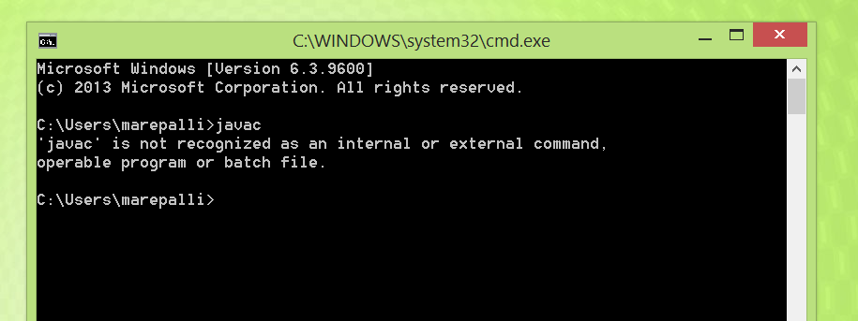
Resolving an error "javac is not recognized as an internal or external command" ?
If there occurs a problem like displayed in the below figure, you need to set path. Since DOS doesn't know javac or java, we need to set path. Path is not required in such a case if you save your program inside the jdk/bin folder. But its good approach to set path.

Slide 54
Java Program compilation
Syntax: javac javafilename.java
Ex: javac HelloWorld.java
javac Test.java
javac Employee.java
javac is a java compiler, it converts java source code to byte code
*.java files are converted in to *.class file by java compiler.

Slide 55
Java Program execution
Syntax: java classfilename with out extension
Ex: java HelloWorld
java Test
java Test.class - wrong
JVM automatically appends .class file to classfile while execution.
When you mention .class explicitly while program execution, Again JVM also appends .class file extension. Then File name will be like Test.class.class
Note: Don’t mention .class file extension while execution of java program

Slide 56
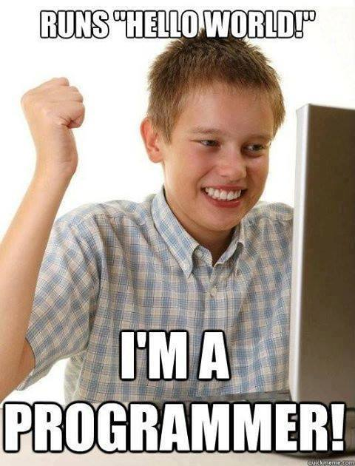

Slide 57
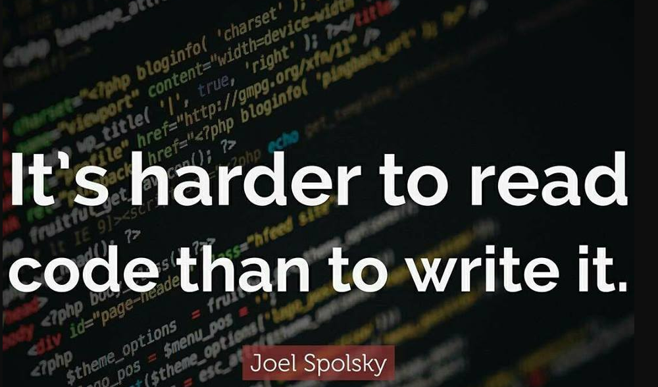

Slide 58
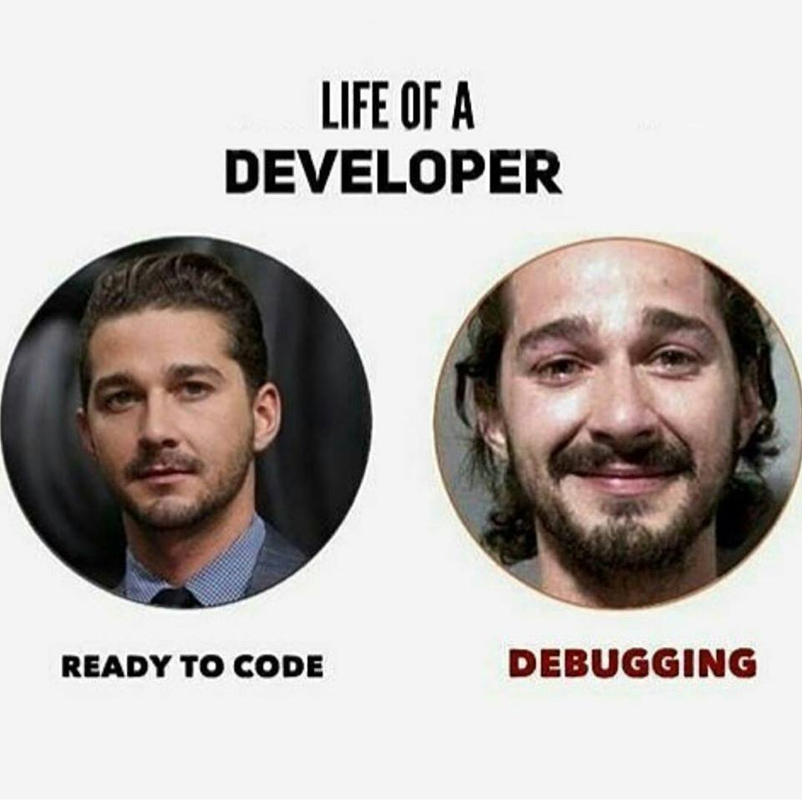

Slide 59
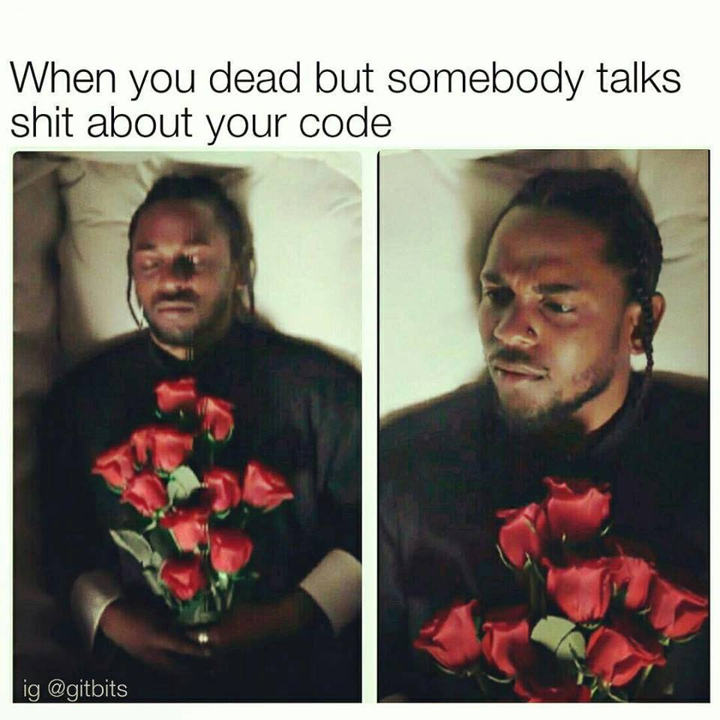

Slide 60
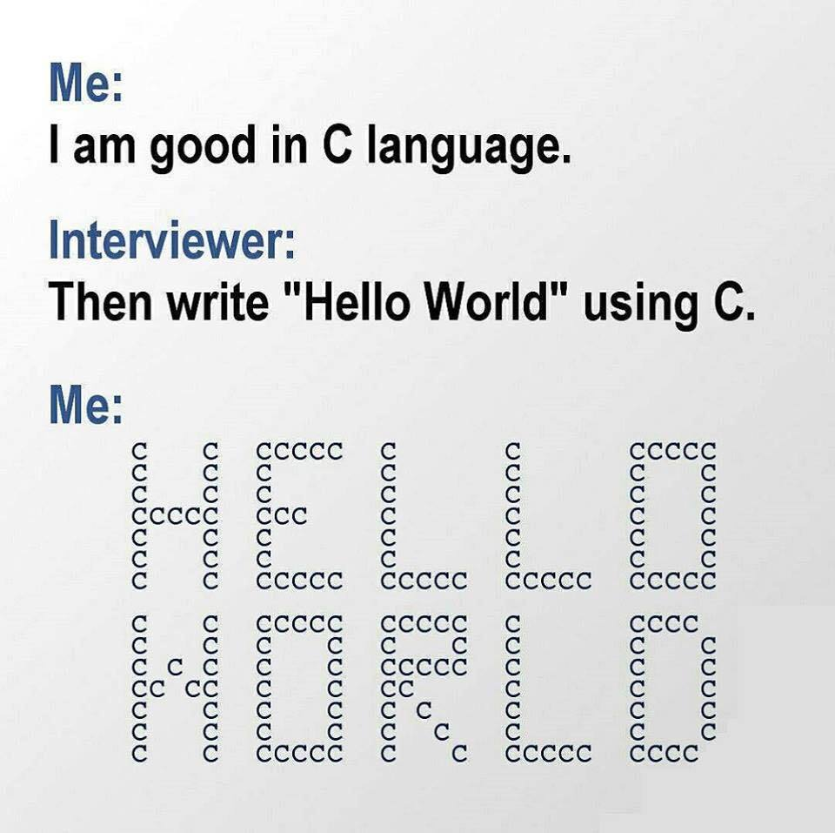

Slide 61
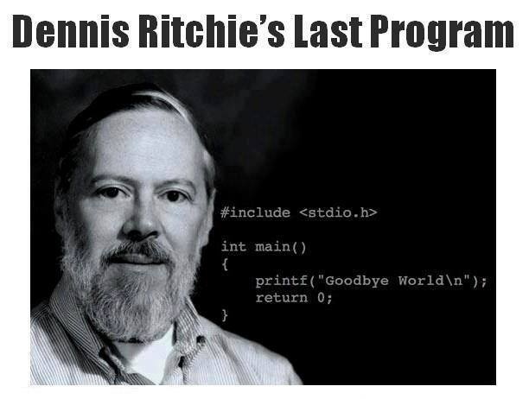

Slide 62
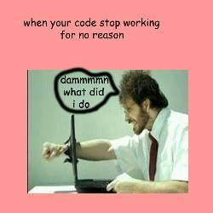

Slide 63
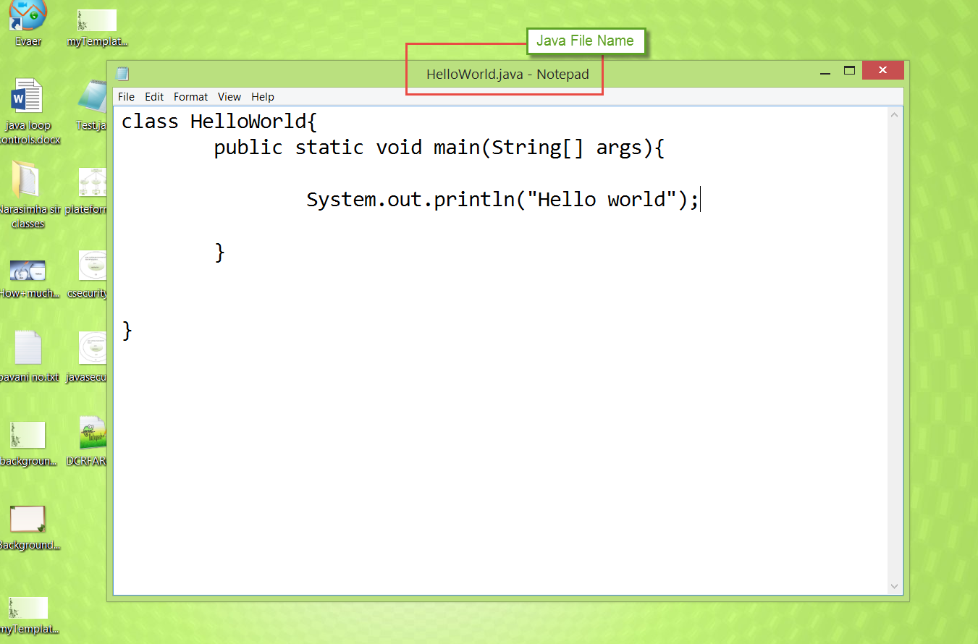
To write the simple program, open notepad by start menu -> All Programs -> Accessories -> notepad and write simple program as displayed below:

Slide 64
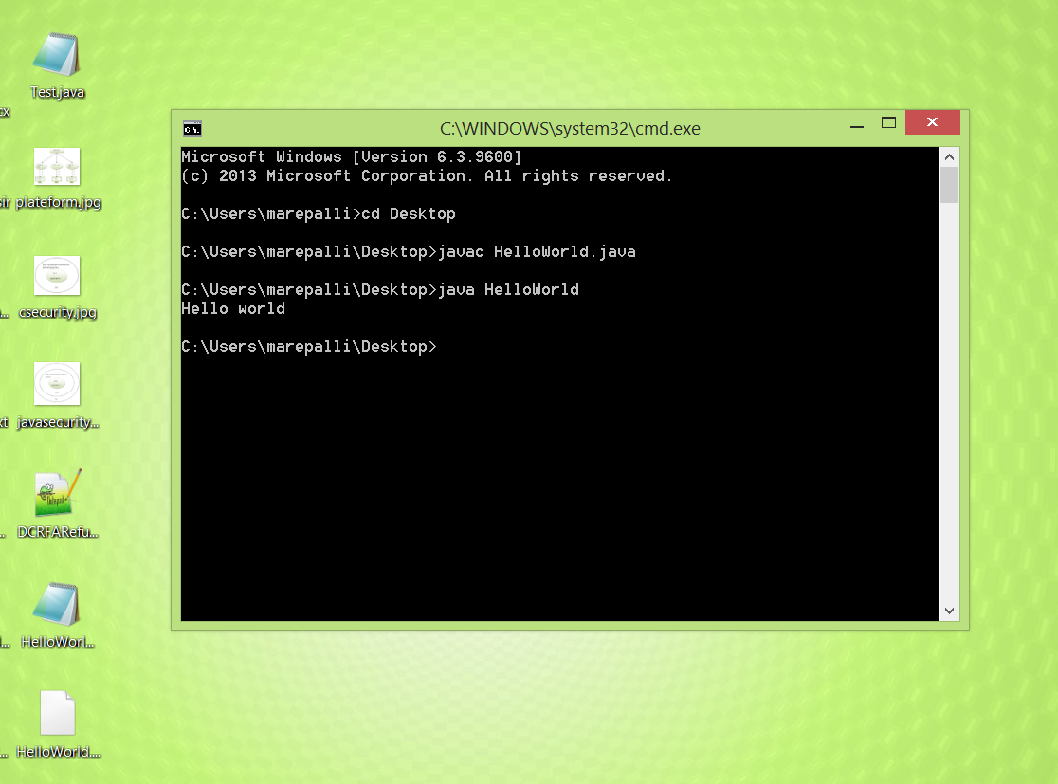
To compile and run this program, you need to open command prompt by start menu -> All Programs -> Accessories -> command prompt.

Slide 65
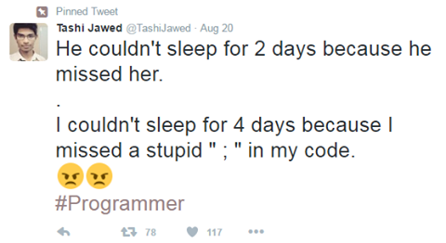
Don’t forget ; to end the statement

Slide 66
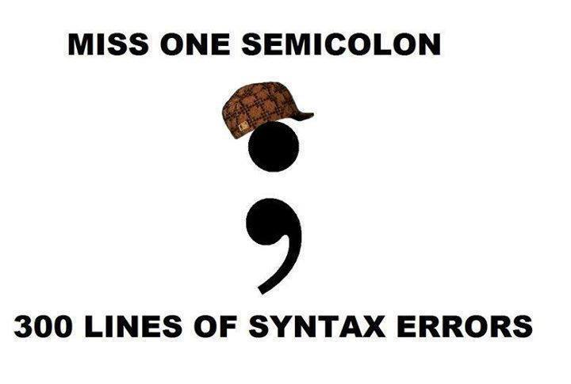

Slide 67
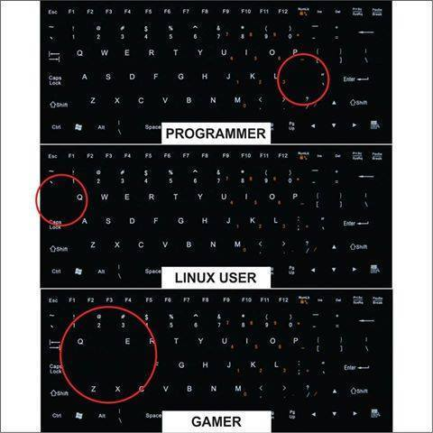
Keyboard usage

Slide 68
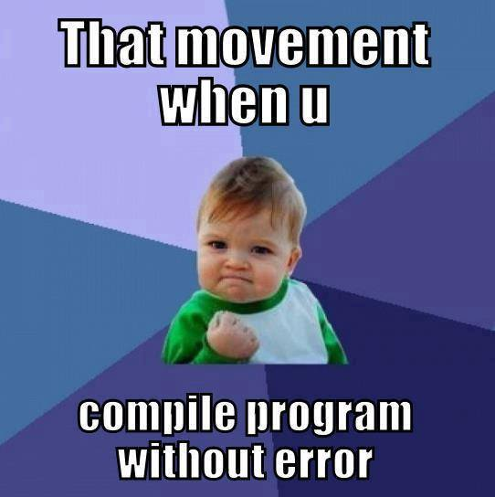

Slide 69
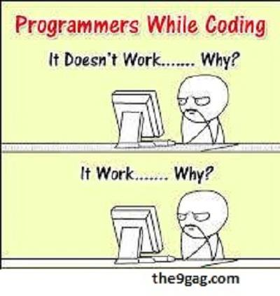
Programmers while coding

Slide 70
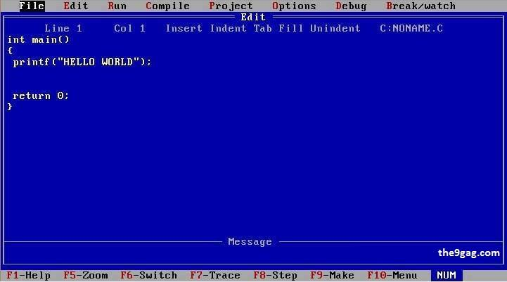

Slide 71
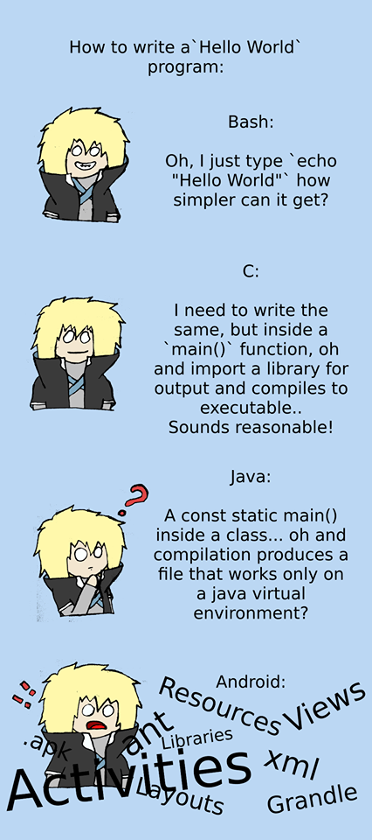
Hello world program in various languages? ☺ ☺ ☺

Slide 72
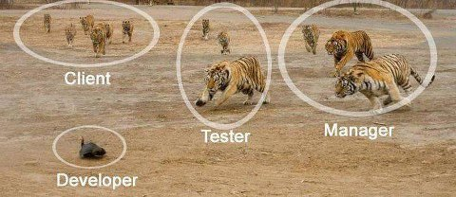
Developer Dependency

Slide 73
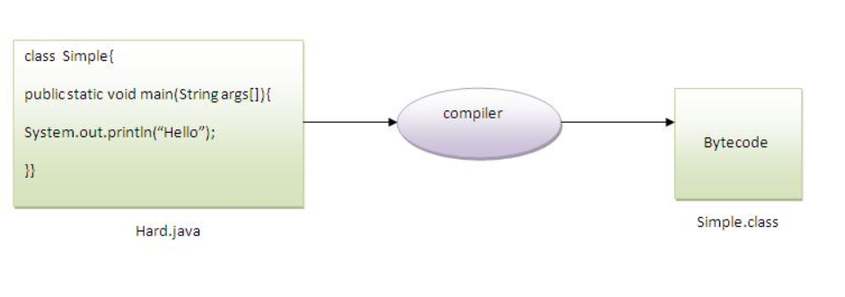
Can you save a java source file by other name than the class name?
Yes, If the class is not public
To compile Hard.java
To execute Sample

Slide 74
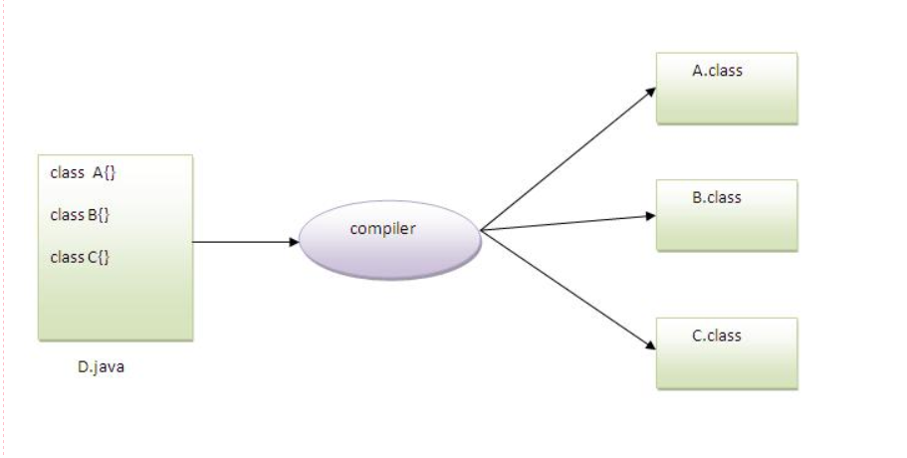
Q)Can you have multiple classes in a java source file?
Yes

Slide 75
Can we compile more than one class at a time?
Yes, We can compile the more than one class at a time.
Syntax: javac A.java B.java C.java or *.java

Slide 76
Can we execute more than one class file at a time?
No, We can execute only one class file at a time
Syntax: java classfilename
Java Test
Java A B C - only A class file will be executed, it doesn’t give any error.

Slide 77
Understanding of First Java program
class keyword is used to declare a class in java.
public keyword is an access modifier which represents visibility, it means it is visible to all.
static is a keyword, if we declare any method as static, it is known as static method. The core advantage of static method is that there is no need to create object to invoke the static method. The main method is executed by the JVM, so it doesn't require to create object to invoke the main method. So it saves memory.
void is the return type of the method, it means it doesn't return any value.
main represents startup of the program.
String[] args is used for command line argument. We will learn it later.
System.out.println() is used print statement. We will learn about the internal working of System.out.println statement later.

Slide 78
How many ways can we write a java program?
There are many ways to write a java program. The modifications that can be done in a java program are given below:
1) By changing sequence of the modifiers, method prototype is not changed.
Let's see the simple code of main method.
static public void main(String args[])
2) subscript notation in java array can be used after type, before variable or after variable.
public static void main(String[] args)
public static void main(String []args)
public static void main(String args[])

Slide 79
3) You can provide var-args support to main method by passing 3 ellipses (dots)
Let's see the simple code of using var-args in main method. We will learn about var-args later in Java New Features chapter.
public static void main(String... args)
4) Having semicolon at the end of class in java is optional.
class A{
static public void main(String... args){
System.out.println("hello java4"); ;;;;;;;;
;;;;;;;;;;;;;;;;;;;;;;;;;;;
} ;
};

Slide 80
Valid main method signatures
public static void main(String[] args)
public static void main(String []args)
public static void main(String args[])
public static void main(String... args)
static public void main(String[] args)
public static final void main(String[] args)
final public static void main(String[] args)
final strictfp public static void main(String[] args)

Slide 81
Invalid Java main method signatures
public void main(String[] args)
static void main(String[] args)
public void static main(String[] args)
abstract public static void main(String[] args)

Slide 82
Difference between JDK, JRE and JVM
JVM, JRE and JDK are platform dependent because configuration of each OS differs. But, Java is platform independent.

Slide 83
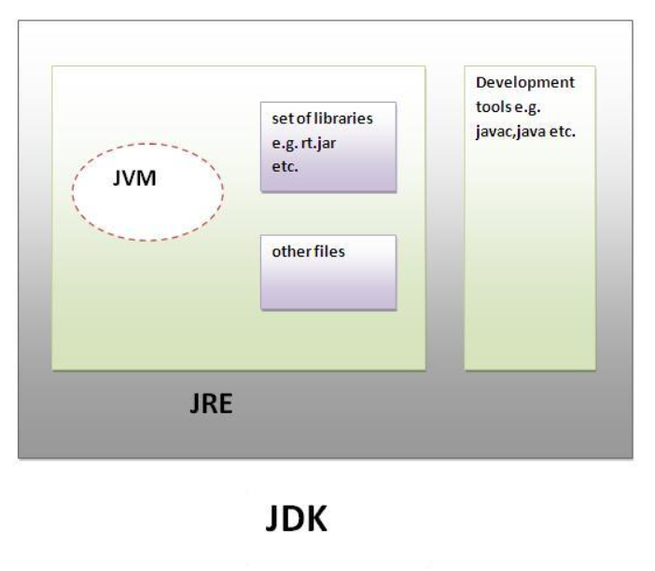
JDK
JDK is an acronym for Java Development Kit.It physically exists.It contains JRE + development tools.

Slide 84
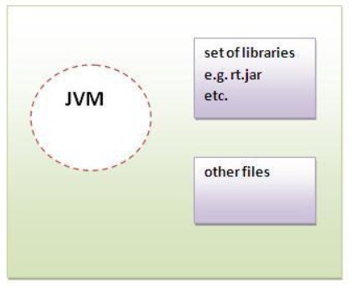
JRE
JRE is an acronym for Java Runtime Environment.It is used to provide runtime environment.It is the implementation of JVM.It physically exists.
It contains set of libraries + other files that JVM uses at runtime.
Implementation of JVMs are also actively released by other companies besides Sun Micro Systems.

Slide 85
JVM
JVM (Java Virtual Machine) is an abstract machine. It is a specification that provides runtime environment in which java bytecode can be executed.
Runtime Instance Whenever you write java command on the command prompt to run the java class, and instance of JVM is created.

Slide 86
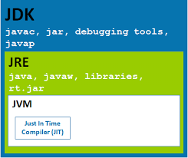

Slide 87
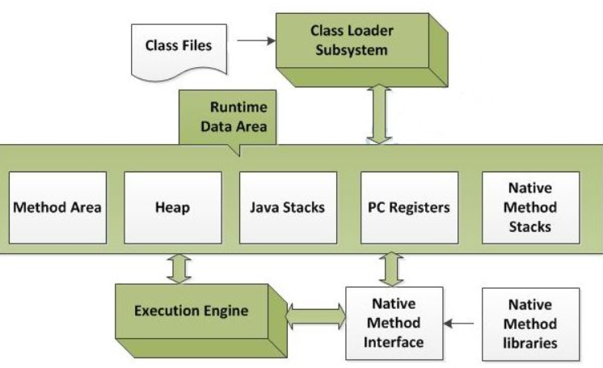
JVM Architecture

Slide 88
1. Classloader
JVM's class loader sub system performs 3 tasks a. It loads .class file into memory. b. It verifies byte code instructions. c. It allots memory required for the program.

Slide 89
2. Run time data area:
This is the memory resource used by JVM and it is divided into 5 parts
Method Area
Heap Area
Java Stacks
Program Counter Registers
Native Stacks

Slide 90
i. Class(Method) Area:
It stores class code and method code

Slide 91
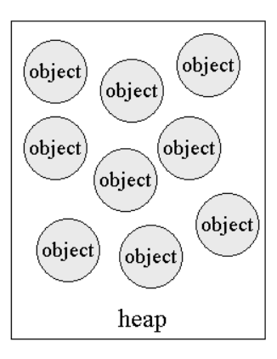
ii. Heap
It is the runtime data area in which objects are allocated.

Slide 92
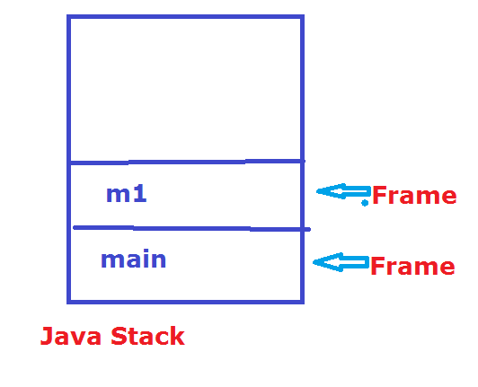
Stack
For each thread separate stack will be created.
Java Stacks are the places where methods are executed.
Java Stack contains frames, on a separate method is executed.
A new frame is created each time a method is invoked. A frame is destroyed when its method invocation completes.

Slide 93
Program Counter Register:
PC (program counter) register. It contains the address of the Java virtual machine instruction currently being executed.

Slide 94
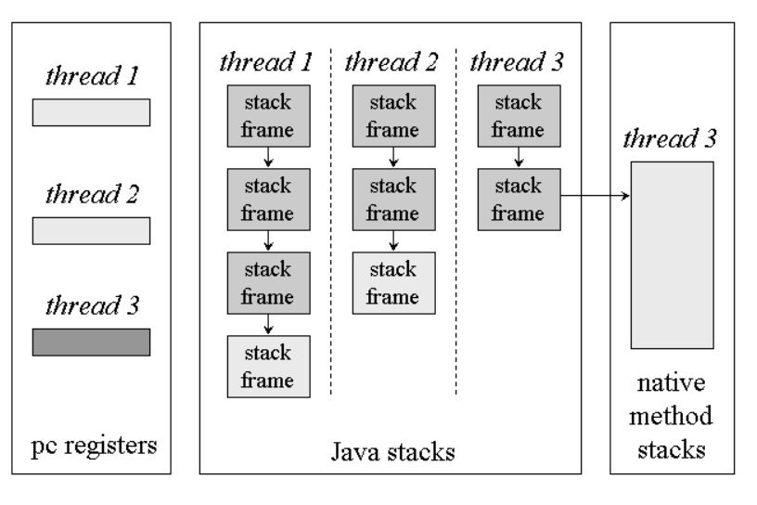

Slide 95
Native Method Stack:
The native method stacks are places where native methods are executed. (for example, C language programs).
Native method is a function, which is written in another language other than Java.

Slide 96
Execution Engine
Execution engine contains interpreter and JIT compiler, which convert byte code into machine code.
JVM uses optimization technique to decide which part to be interpreted and which part to be used with JIT compiler. The HotSpot represent the block of code executed by JIT compiler.

Slide 97
Native Method Interface
Native method interface is a program that connects native methods libraries (C header files) with JVM for executing native methods.

Slide 98
Native method library:
It holds native libraries information

Slide 99
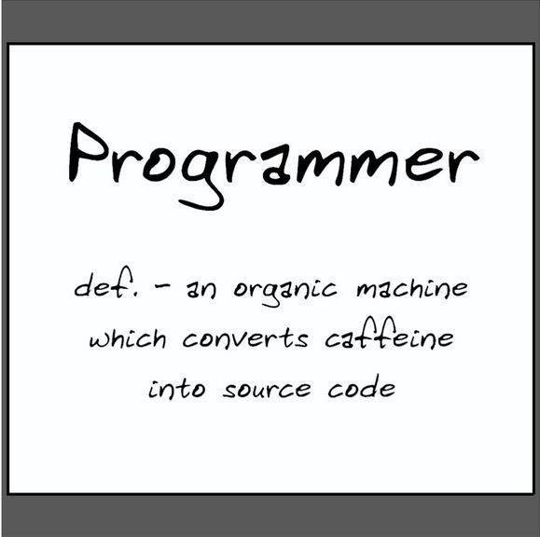
Define Programmer?? ☺

Slide 100
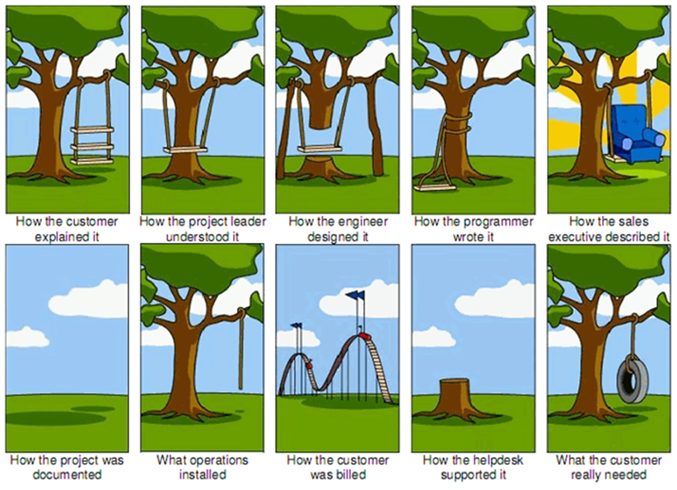
Sound Familiar

